Slide 1
Community Update
Mojaloop PI-13 Online Community Meeting
Simeon Oriko

Slide 2
Looking back

Slide 3
2020 Reflections
Formalize communty management
01
Strengthen governance through transparency and community participation
02
Create awareness and communicate Mojaloop activities
03
Develop community infrastructure
04
Notes:
Put in place a structured system for responding to non-tech and community related issues that directly support the community and responds to its needs.
2. Assist the community to understand Mojaloop’s governance structures: their makeup, their workflow and how they can engage and participate.
3. The goal is to put in place a system and tools to share information across different member profiles and work streams to ensure everyone in the community is aware of what’s taking place. In addition, find and utilize opportunities to advocate and evangelize mojaloop in other spheres.
4.

Slide 4
Restructured Community Governance
Community Council
Change Control Board & Special Interest Groups (SIGs)
Design Authority
Product Council

Slide 5
Looking ahead

Slide 6
2021 will be the year of…
Cost Reduction
… as measured by the checklist of manual steps to go from “yes” to running a sufficiently complete hub, and the monthly operational cost at low traffic levels
Removing Friction
… as measured by the marketing funnel steps
Understanding and Resolving Gaps through the eyes of Adopters to enhance traction
... As measured by no of APIs & use cases being tested/reviewed at least to POC level, level of issues raised by adopters & resolved, & amount of code contributed back by POC projects
Confidence in our claim of Trustworthy, Quality & Credible
… as measured performance statistics the main code branch, and no of deals/Sandboxes/POCs/larger scale deployments that are running real money by year end… and of organic press mentions by influencer/adopter community advocating mojaloop
“Ready for Production”

Slide 7
2021 Community Objectives
Reduce friction for adopters and contributors
Attract and/or grow new constituencies of contributors
Diversify contributions
Trust + Collaboration

Slide 8
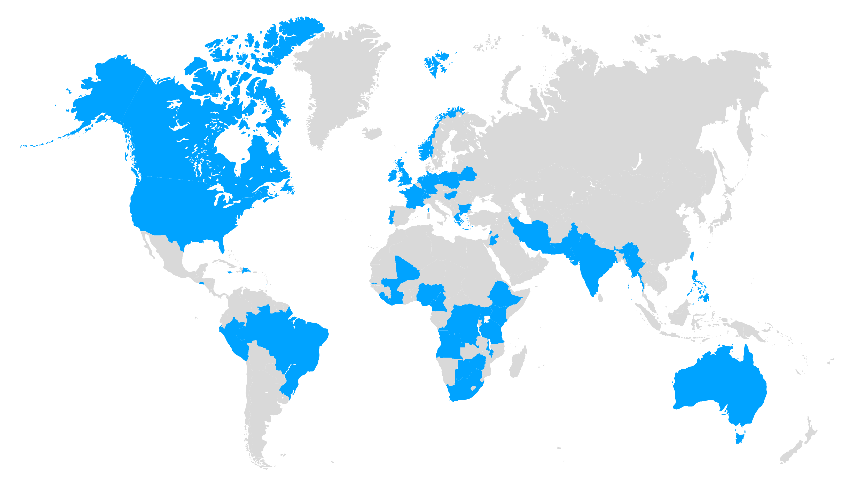
The Mojaloop Community
2016
520 days
368 days
362 days
361 days
659
6
47
10
Participants and growing!
Continents
Countries
Sponsor/
Promoter
Members

Slide 9
Who’s in our community?
Solution vendors and System Integration companies building products compatible to Mojaloop API & Core Hub
Training and consultancy organizations supporting the ecosystem

Slide 10
Who else do we want in our community?
Large consultancies & development sector players who run infrastructure projects at a national level
Individuals that will work for DFSPs, Hub Operators & Government/Regulators
Corporate Contributors

Slide 11
Engage
Community Forum: http://community.mojaloop.io
Mojaloop Slack:
Registration: https://mojaloop-slack.herokuapp.com
Slack Channel: https://mojaloop.slack.com
Mojaloop Github: https://github.com/mojaloop
Documentation: https://docs.mojaloop.io/documentation

Slide 12
Happy Hour Wednesday
16:00 UTC
Turn on your cameras, grab a beverage, and let’s chat!
And we will capture a “screenie”.

Slide 13
Thank you
soriko@mojaloop.io

